Slide 1



Cyclistic Bike-Share Case study
Google Data Analytics Capstone Project
Presented by
Smruti Arjani

Slide 2
Overview
03
04
05
04
07
08
09
10
19
20
About the company
Current Marketing Strategies
Scenario
Case Study Roadmap
Ask
Prepare
Process
Analyze
Share
Act

Slide 3



About the company
In 2016, Cyclistic launched a bike-share program.
Current fleet of 5824 geotracked bikes and 692 locking stations across Chicago.
Flexible plans: Single-ride passes & full-day passes for casual riders and annual memberships for Cyclistic members.
Annual members are much more profitable than casual riders

Slide 4




Increasing brand outreach
Cyclistic’s Current
Marketing Strategies
Flexible price plans
Increasing mass appeal

Slide 5

Scenario
Act a junior data analyst on the marketing analyst team at Cyclistic.
The director of marketing believes maximizing the annual memberships by focusing on converting casual riders to annual members could lead to more success.
As a data analyst, I have been tasked to understand the how the annual members and casual riders use bike differently.

Slide 6










Case Study Roadmap
Gather data for analysis ensuring its credibility
Explore and analyze the data to identify solutions to the business problem
Provide recommendations and actionable insights to the business problem
Prepare
Analyze
Act
Ask
Process
Share
Identify the business problem and key metrics to evaluate
Transform, clean and manipulate data to make it analysis ready
Share the findings with the stakeholders using visualizations

Slide 7

Ask
In the ask phase, we collaborate with stakeholders on the project to identify the business problem. The stakeholders on this project are:
The Director of Marketing
Cyclistic marketing analytics team
Cyclistic executive team
The business challenge is to increase the conversion of casual riders into annual members, as annual memberships are more financially beneficial for Cyclistic. Therefore, the focus is on developing strategies to encourage casual riders to become annual subscribers.
As a Junior Data Analyst, I have been asked to explore the riding patterns between casual riders and annual members to find solutions for this business challenge. The key metrics identified to compare between the two groups were:
Type of bike usage
Average trip duration
Peak time, weekday and month when the casual riders preferred to ride
Average ride duration by each day of the week
Number of rides by the time of the day and day of the week
Spatial mapping of most frequently used start and end stations which could be used for future marketing initiatives

Slide 8


Prepare
In this phase, we gather data from data sources available, assessing whether the data is Reliable, Original, Comprehensive, Current and Cited (ROCCC).
For this case study, we will be using Cyclistic’s own historical data for the previous 12 months by making sure we are using the recent data. This data is stored using licensed third-party cloud services making it secure and confidential. Since the data is collected directly from the bikes geotracking system, there is no bias to be introduced and the data can be considered to be ROCCC compliant.
The data is organized by month and year and details the ride information for each taken during the time period. Some of the rides details included are:
Bike types used (Electric, classic and docked)
Start and end times for the rides
Start and end stations along with their corresponding latitude and longitude coordinates
Rider subscription status (annual member or casual rider)

Slide 9






Process
Raw data in .csv format was downloaded and imported to R Studio for data cleaning and analysis.
R markdown file was used to document the process.
New variables calculated for analysis purpose were:
Time, day, month, and weekday were extracted from start date
Trip duration - calculated as difference between start and end date time in minutes
Number of rides by the time of the day
Some common errors and inconsistencies noted in the data and the steps taken to rectify them were:
Incorrect data types for factor and date time variables
Character variables converted to factors and appropriate data time formats
Missing data for start and end stations
Data with missing stations were excluded from analysis
Duplicate records for 121 rides
Duplicate records were excluded from the analysis
Errors in chronological order of start and end date
Records with trip duration less than 1 minute were excluded
Extreme outliers in the trip duration
Extreme outliers were excluded from the analysis
Start and end stations from outside Chicago city boundaries
Stations outside the city boundaries were excluded

Slide 10

Analyze

Slide 11
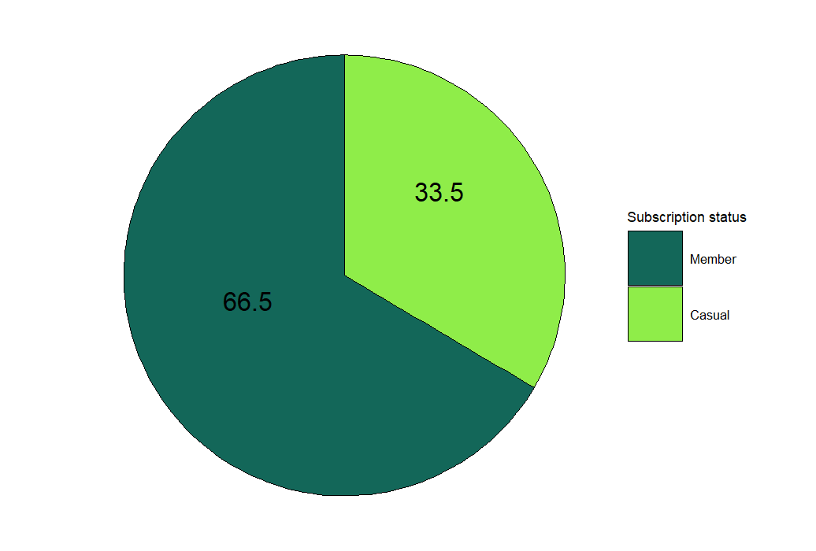
40,03,086 ~ 4 million
Total Number of Rides in last 12 months

Slide 12


5,19,00,904
Total Ride Duration in minutes
Member
Casual
3,06,09,442 Mins
2,12,91,462 Mins

Slide 13
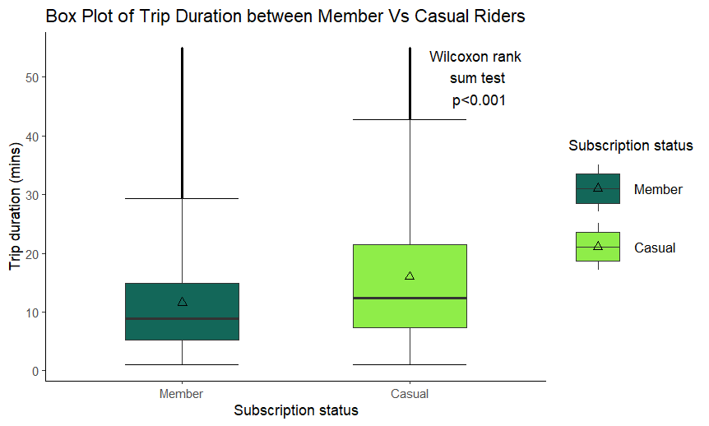
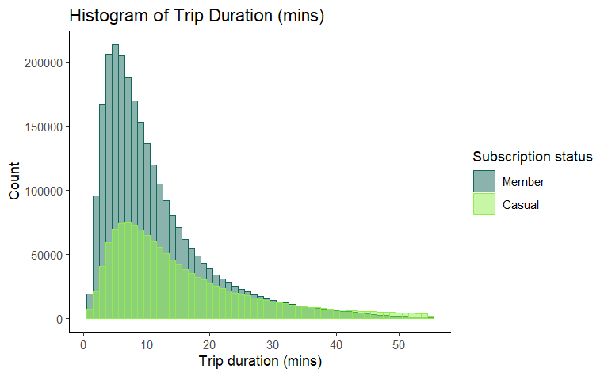
Trip Duration
Summary Stat for Trip Duration (Mins) | Member | Casual
Mean (SD) | 12 (9) | 16 (12)
Median (IQR) | 9 (5 – 15) | 12 (7 – 21)
Min - Max | 1 – 55 | 1 – 55

Slide 14
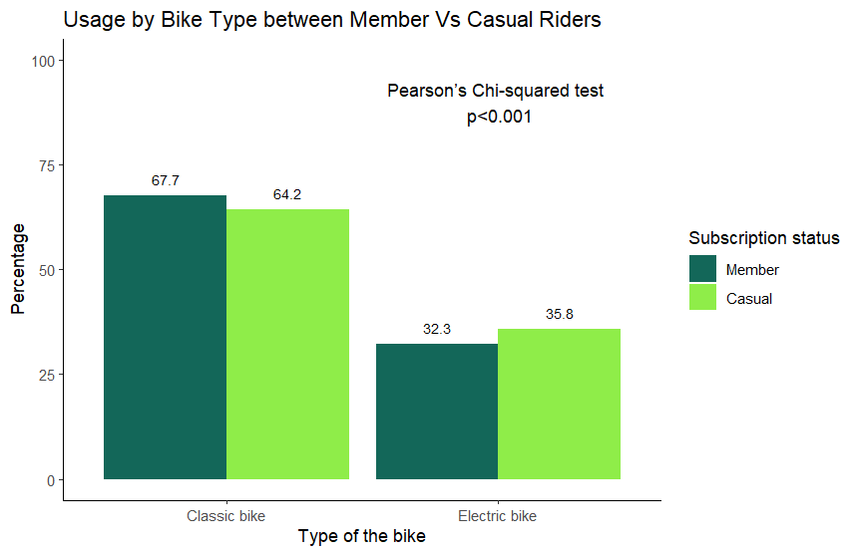
Type of Bike
Electric Bike
32.3% of the members preferred to ride as compared to 35.8% of the casual riders.
Classic Bike
67.7% of the members preferred to ride as compared to 64.2% of the casual riders.
Overall, it was observed that the members preferred to ride classic bikes while the casual riders preferred to use the electric bikes.

Slide 15

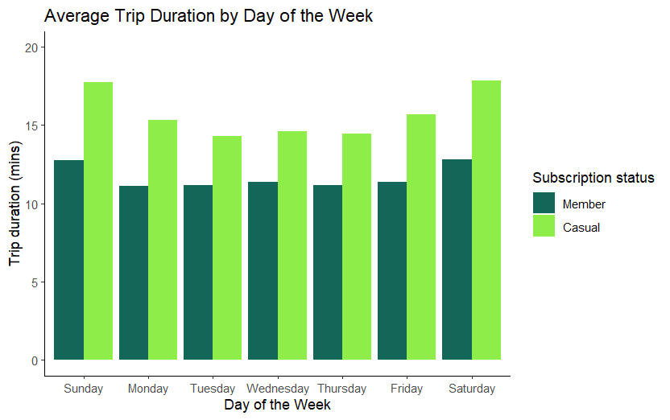
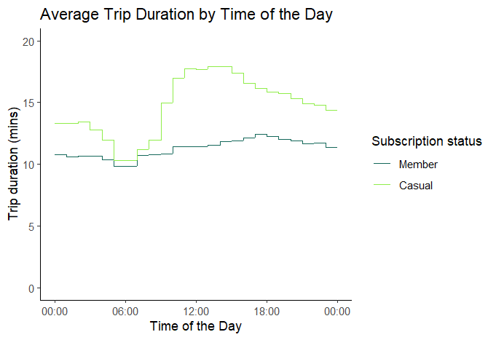
Average Trip Duration By Day of the Week & Time of the Day
This visualization shows that average trip duration among members is highest during weekdays (Monday to Friday), while the average trip duration for casual riders tend to be more on weekends.
This visualization indicates that the average trip duration for members is almost constant through out the day whereas the casual riders tend to ride for longer from mid day to evening.

Slide 16
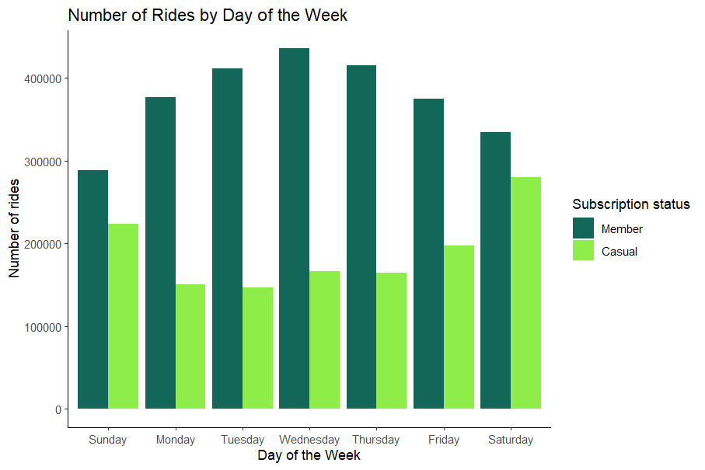
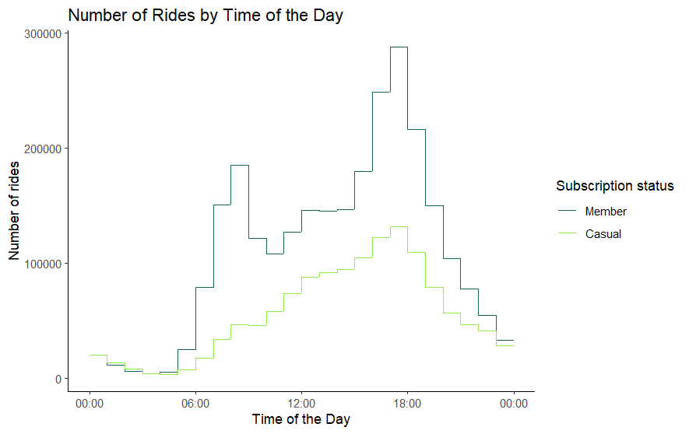
Number of Rides by Day of the Week and Time of the Day
This visualization shows that bike usage among members is highest during weekdays (Monday to Friday), while casual riders tend to use bikes more on weekends.
This visualization indicates that members primarily use bikes during peak work hours, whereas casual riders tend to ride mainly in the evenings.

Slide 17
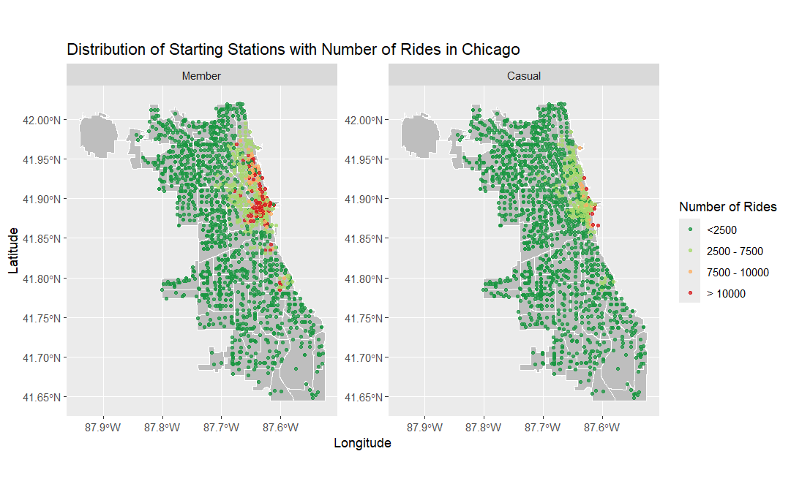
Most Frequent Start Stations
Notes:
Map Citation: City of Chicago [map]. "Neighborhood boundaries in Chicago, as developed by the Office of Tourism." Last updated July 2018. <https://data.cityofchicago.org/d/bbvz-uum9?category=Facilities-Geographic-Boundaries&view_name=Boundaries-Neighborhoods> (accessed September 28, 2024).

Slide 18
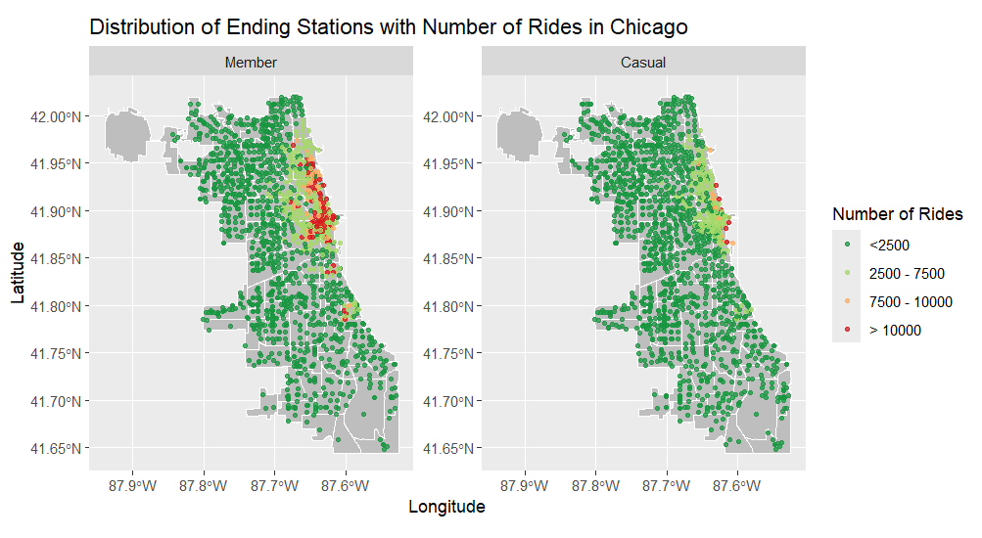
Most Frequent End Stations
Notes:
Map Citation: City of Chicago [map]. "Neighborhood boundaries in Chicago, as developed by the Office of Tourism." Last updated July 2018. <https://data.cityofchicago.org/d/bbvz-uum9?category=Facilities-Geographic-Boundaries&view_name=Boundaries-Neighborhoods> (accessed September 28, 2024).

Slide 19
Share/Conclusion
Over the last 12 months, close to 4 million rides were taken, with casual riders representing 33.5% and members making up 66.5% of all rides
Median trip duration in casual riders was significantly higher as compared to members
Majority of the rides taken by members were between 5 to 15 mins whereas casual rides tend to take rides for 7 to 21 mins
It was observed that the members preferred to ride classic bikes while the casual riders preferred to use the electric bikes
Average trip duration on weekends was reportedly higher as compared to the weekdays for both member and casual riders
Members predominantly used bikes on weekdays and during peak work hours, while casual riders primarily preferred to ride on weekends and in the evenings
The most popular start and end stations for members, each with over 10,000 rides, were situated in central Chicago as well as the north and south sides. In contrast, casual riders primarily began and finished their rides from stations in central Chicago

Slide 20
ACT
The insights from this analysis could be used to use to develop targeted marketing initiatives at the most frequently used start stations by the casual riders
Further analysis that incorporates cost-effectiveness could provide insights into the additional spending of casual riders compared to members
Given that casual riders favor electric bikes over classic bikes, offering reduced membership fees for electric bike usage could be an effective incentive

Slide 21





THANK YOU
Smruti Arjani
smruti.arjani@gmail.com
https://www.linkedin.com/in/smruti-arjani/
https://github.com/Smruti272/Data-Analytics-Portfolio
Edmonton, AB, CA

